Slide 1
Python course 1
First glance

Slide 2
Using jupyter-notebook
Startup you virtual machine
Startup jupyter-notebook
Open url in explorer
Create notebook
Rename it
Save it

Slide 3
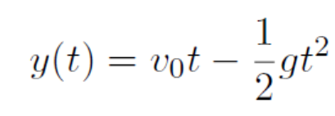
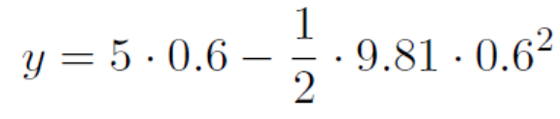
Formula calculator
Problem:
Code:
* Note: Python 2 vs Python 3: print A → print(A)

Slide 4
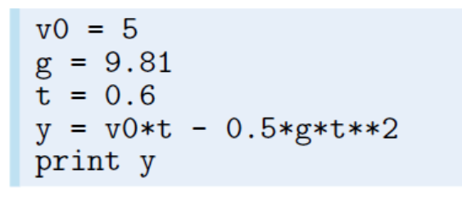
Use Variables

Slide 5
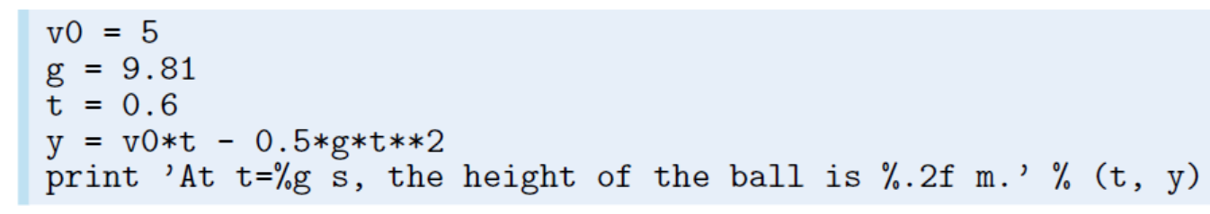
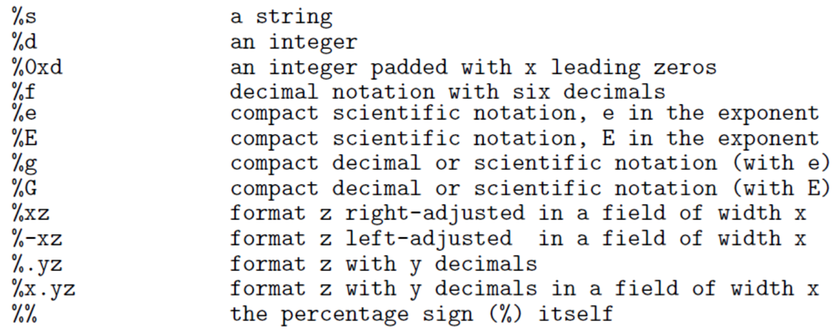
Formatting Output

Slide 6
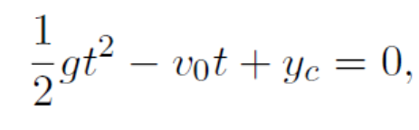
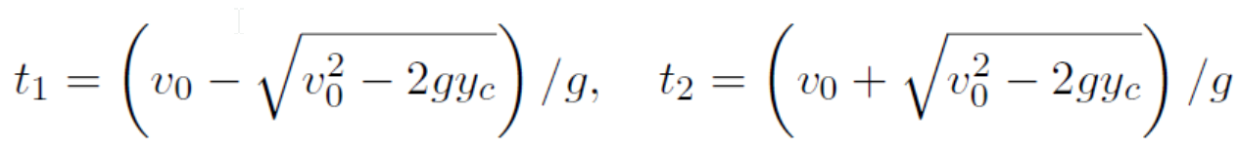
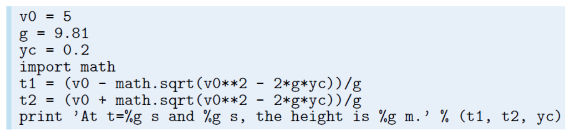
Math library

Slide 7


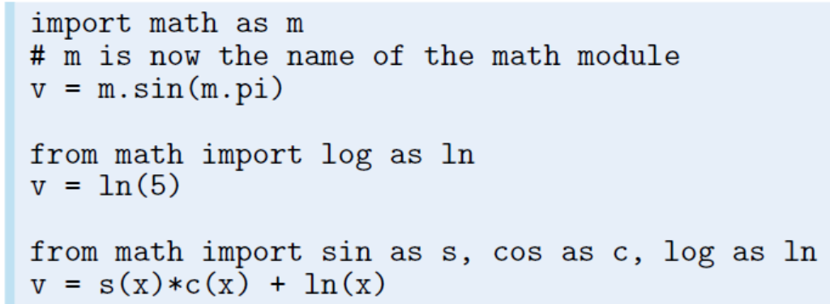
Import library

Slide 8
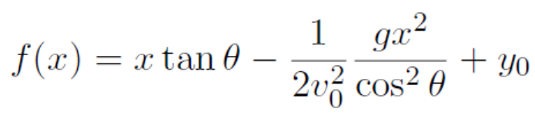
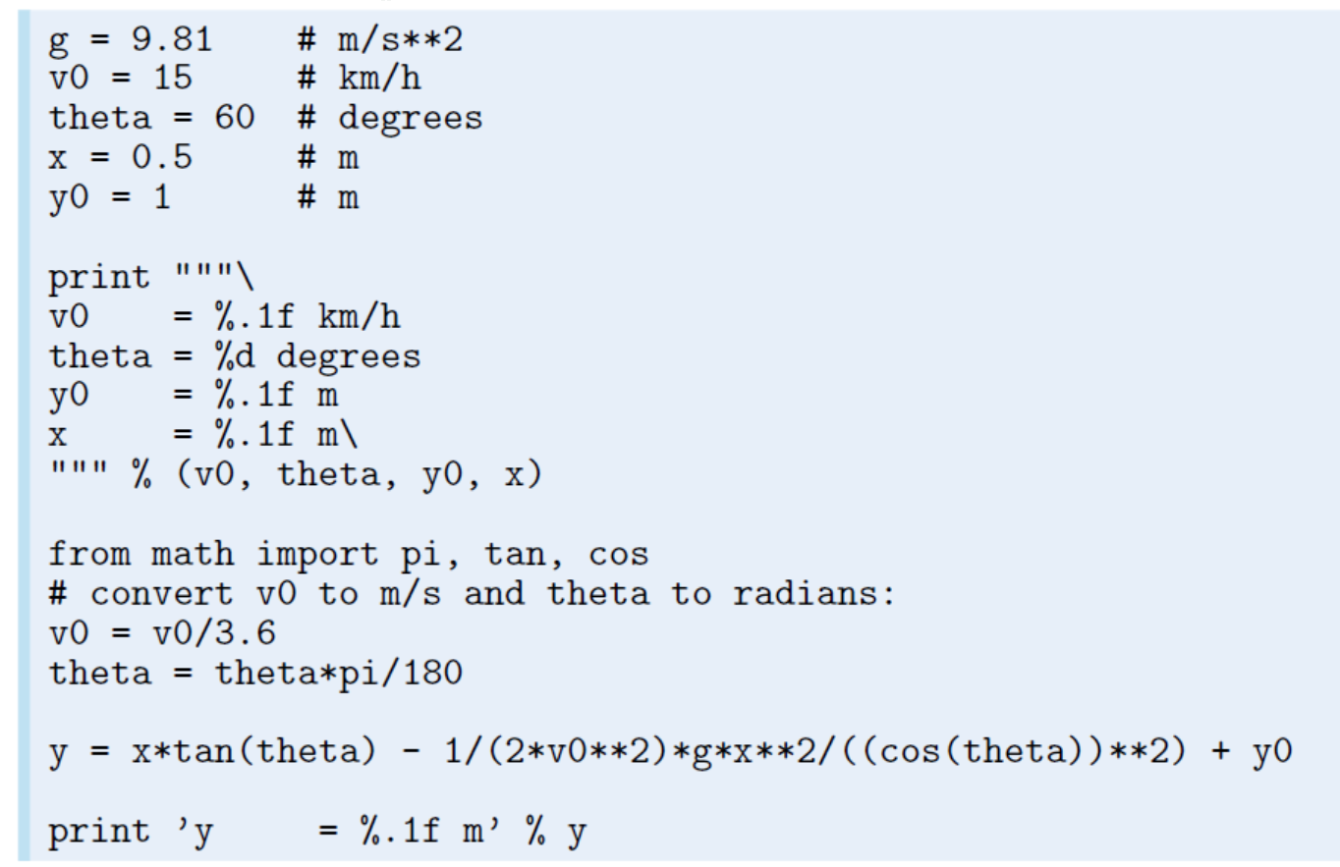
Problem: Trajectory of a ball

Slide 9
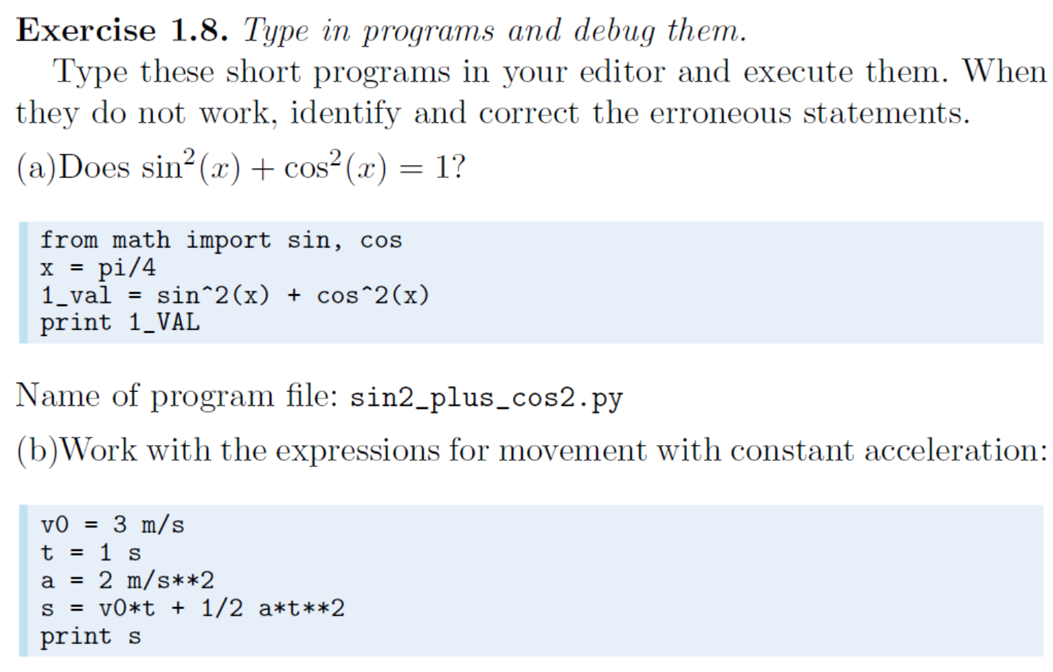

Slide 10
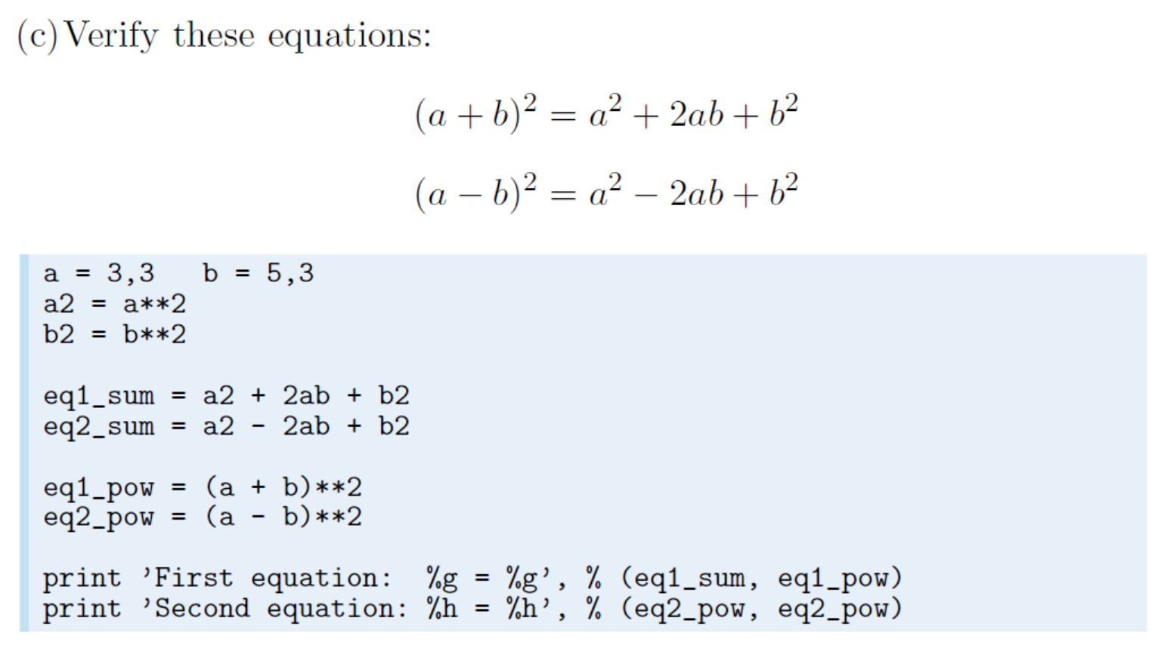

Slide 11
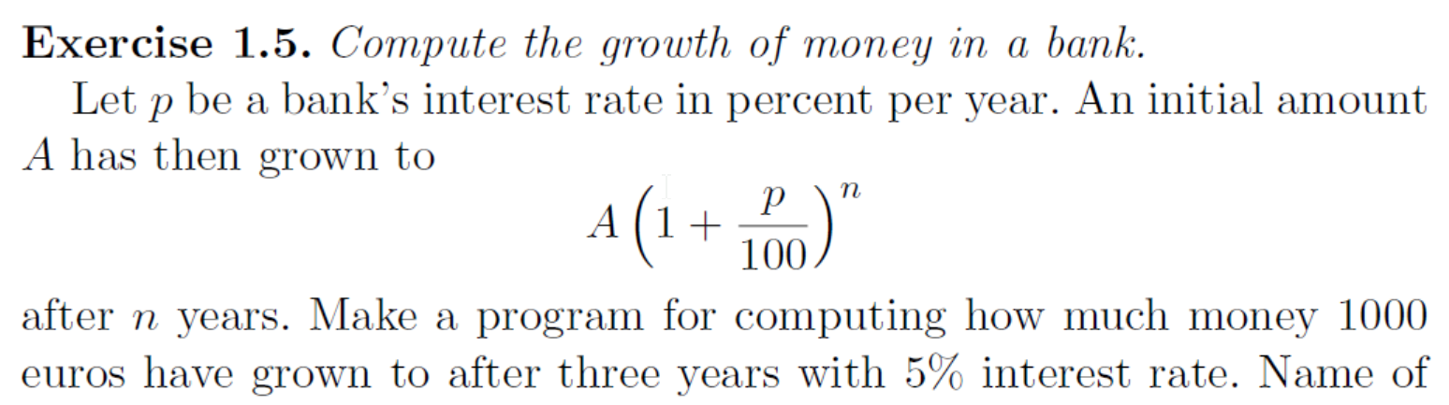

Slide 12
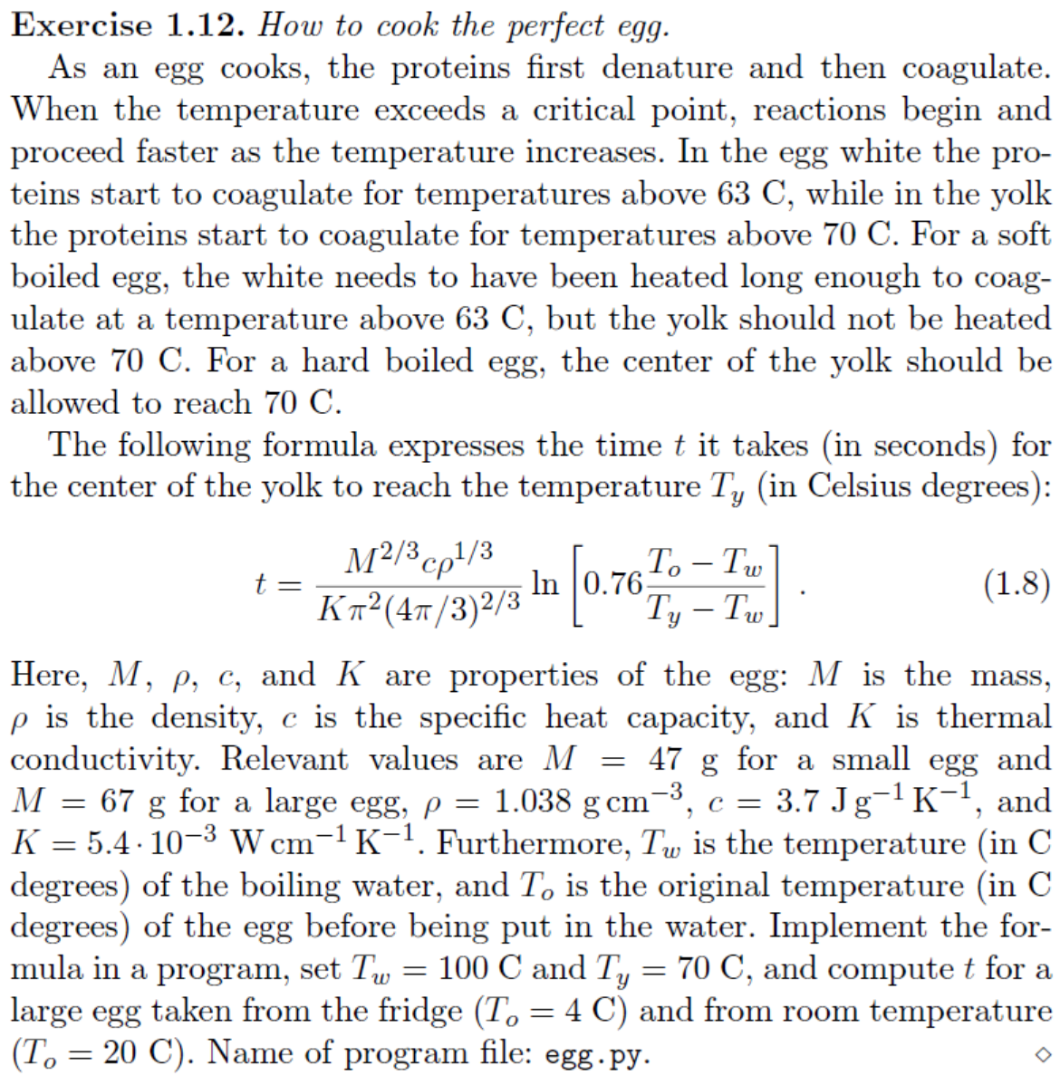

Slide 13
Appendix: Markdown syntax
Head: ##A
List: *, +, -, 1.
Emphasis: *A*, _A_, **A**, __A__
http://wowubuntu.com/markdown/
https://daringfireball.net/projects/markdown/syntax

Slide 14
Next Class
Loop
Boolean expression
List, tuple
Function

